Slide 1

“How much left?”
Food/ water level monitor for your pet via Bluetooth

Slide 2
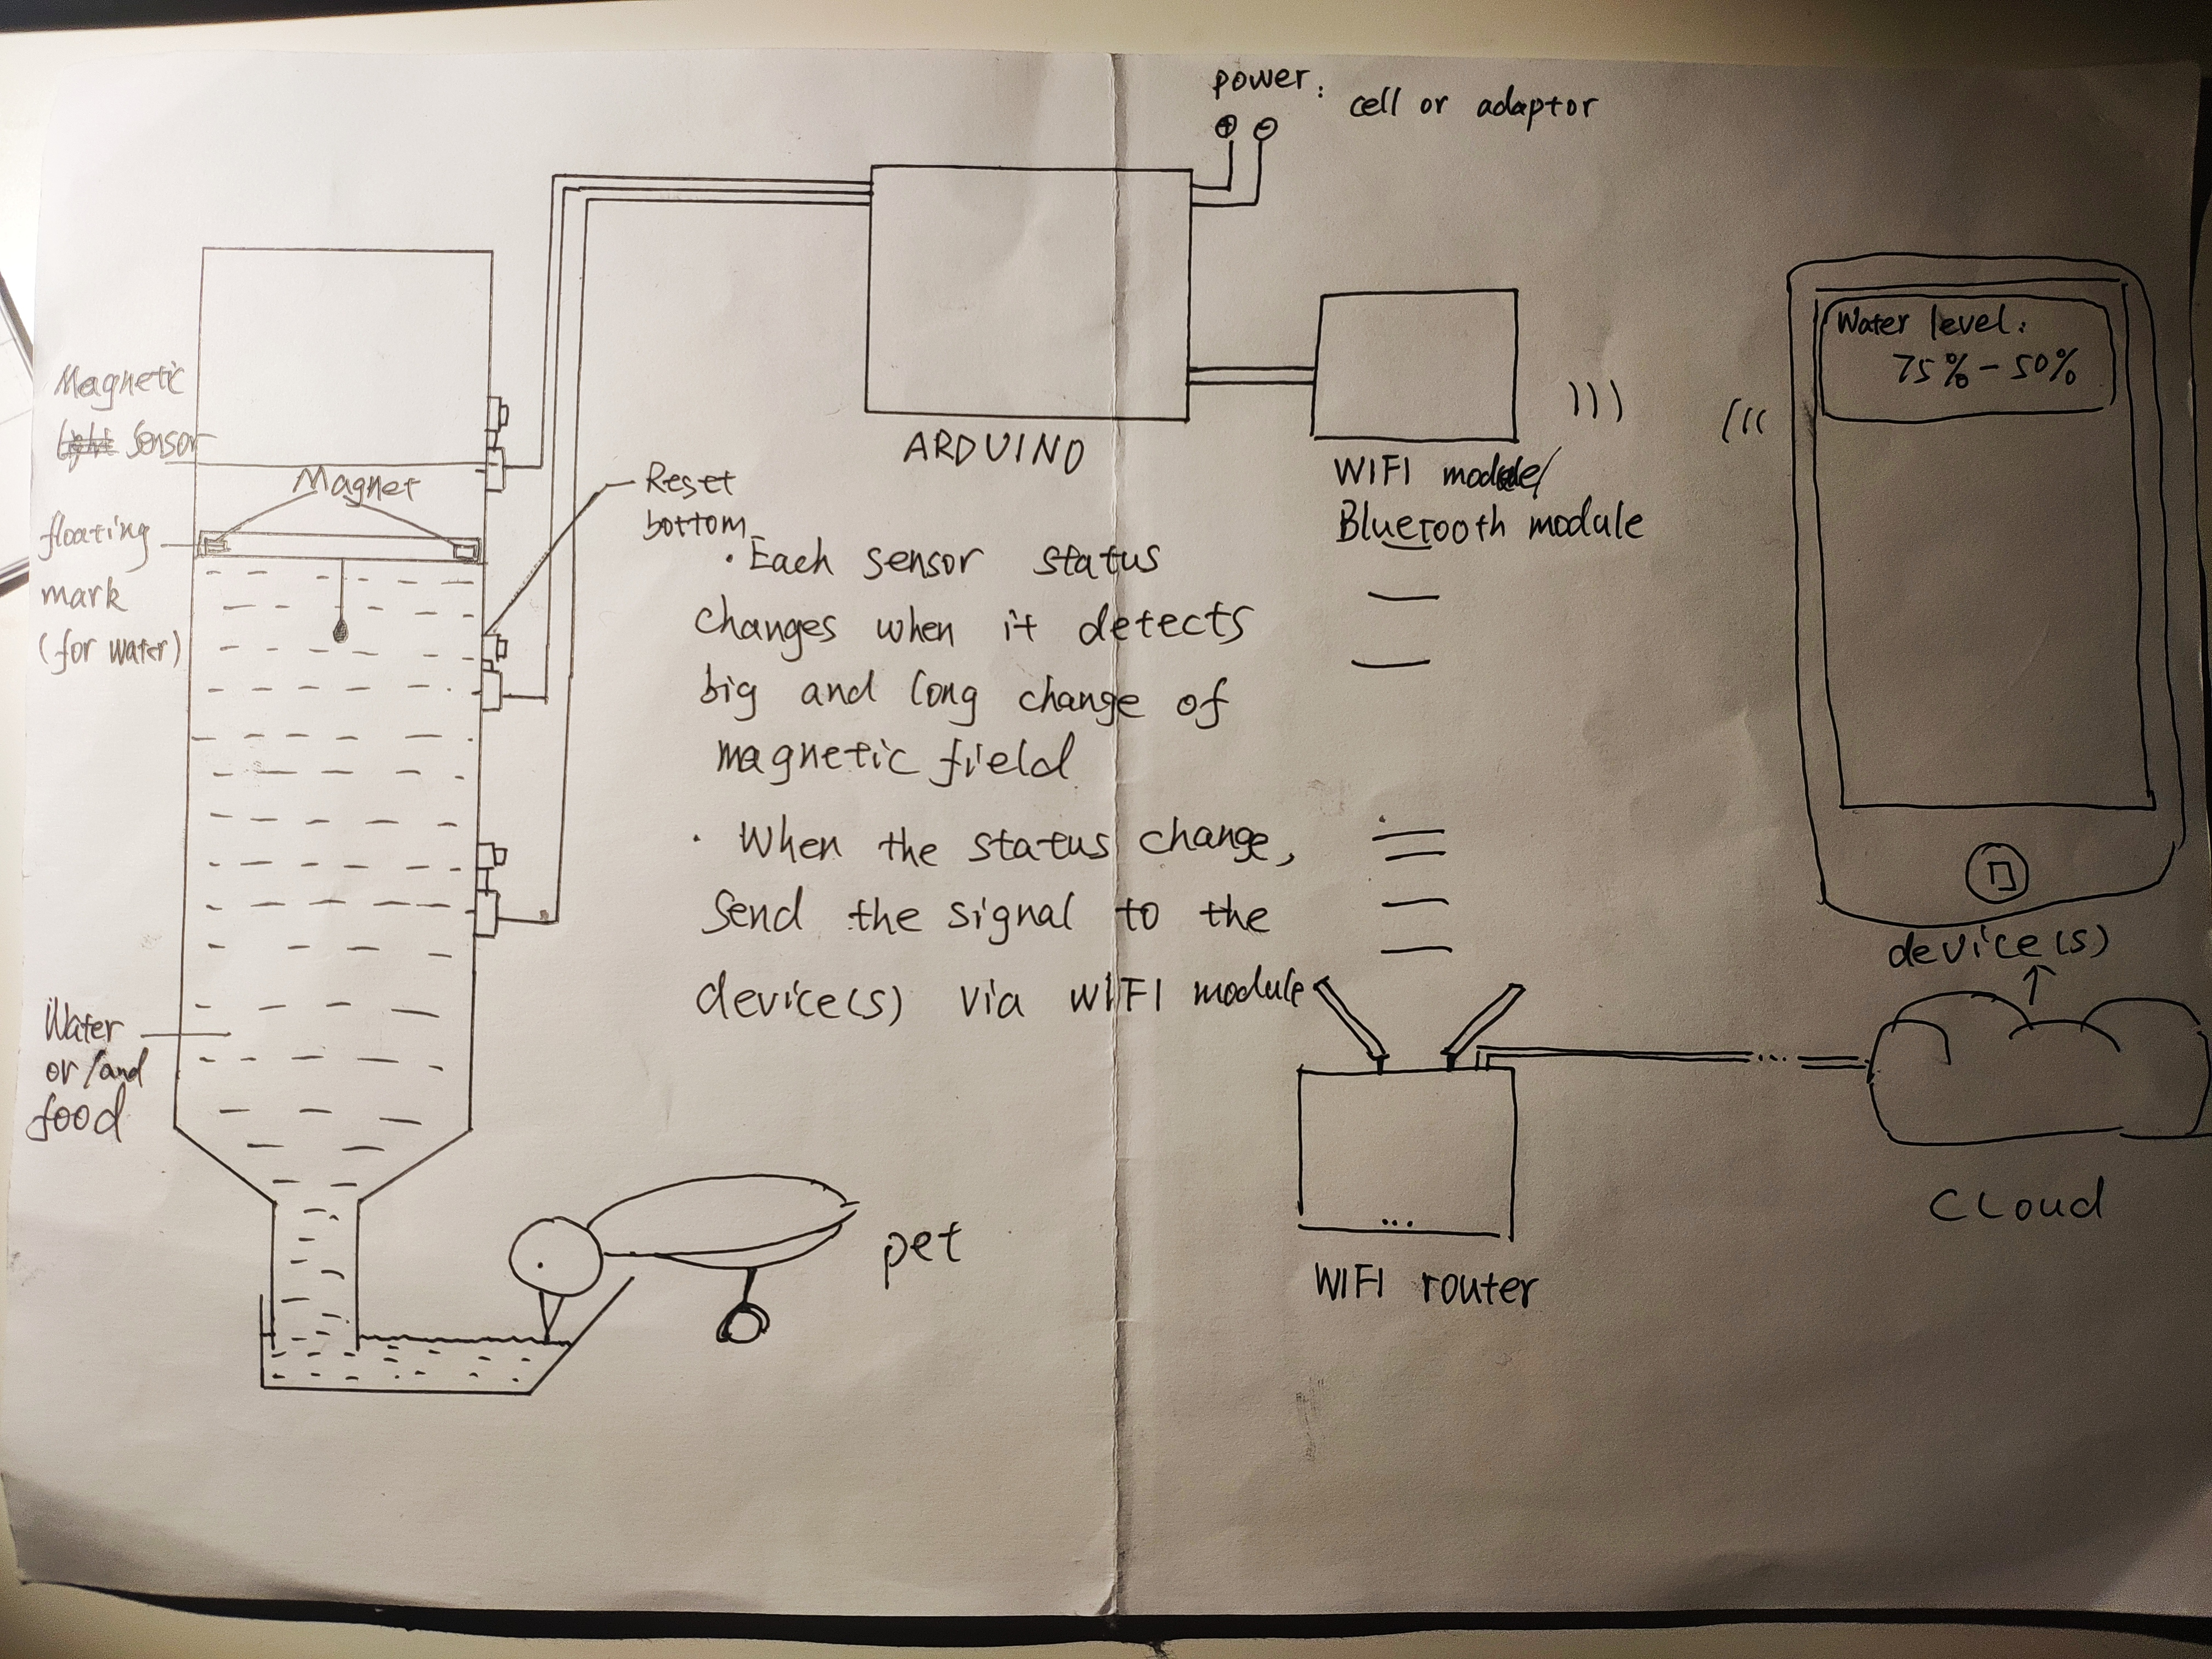


Principle & Design
How to maintain food/ water level in the slot?
Physics: Instead of using pumps, I make use of the gravity.
For liquid, air pressure on the top holds up the water in the container.
For solid particles, the friction among those particles will hold each other.
Electronic: The Arduino will mention the user to refill the container in time
By using floating mark attached with magnets, which is on the surface inside the cylinder, and the hall effect sensor which can feel the magnets, Arduino is able to know the level of food/ water.
Arduino will inform the user when the level of food/ water changes via Bluetooth .

Slide 3
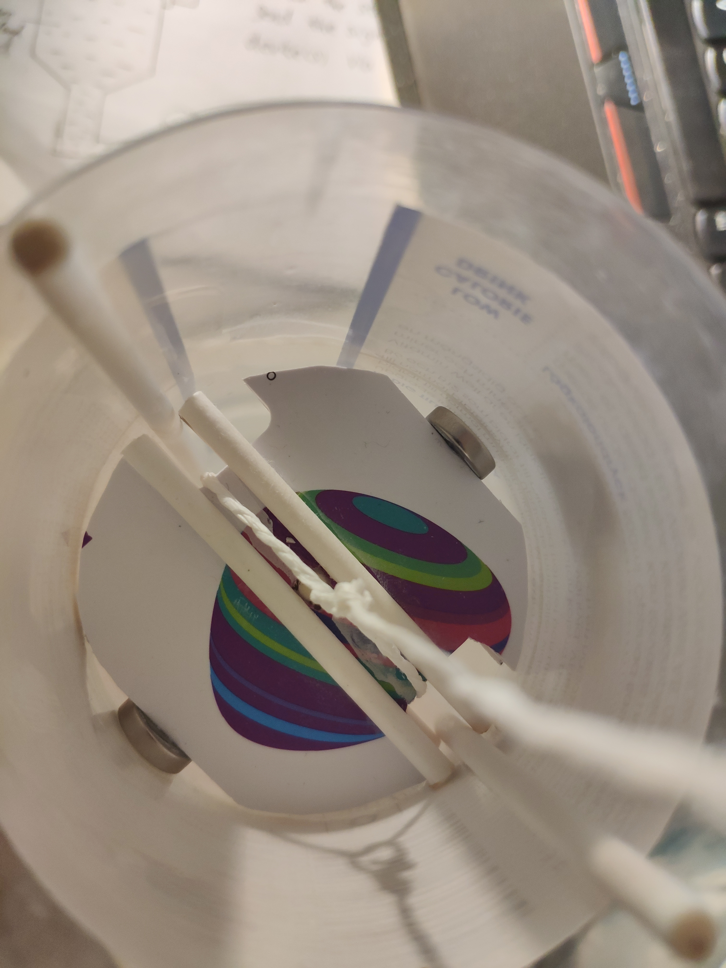
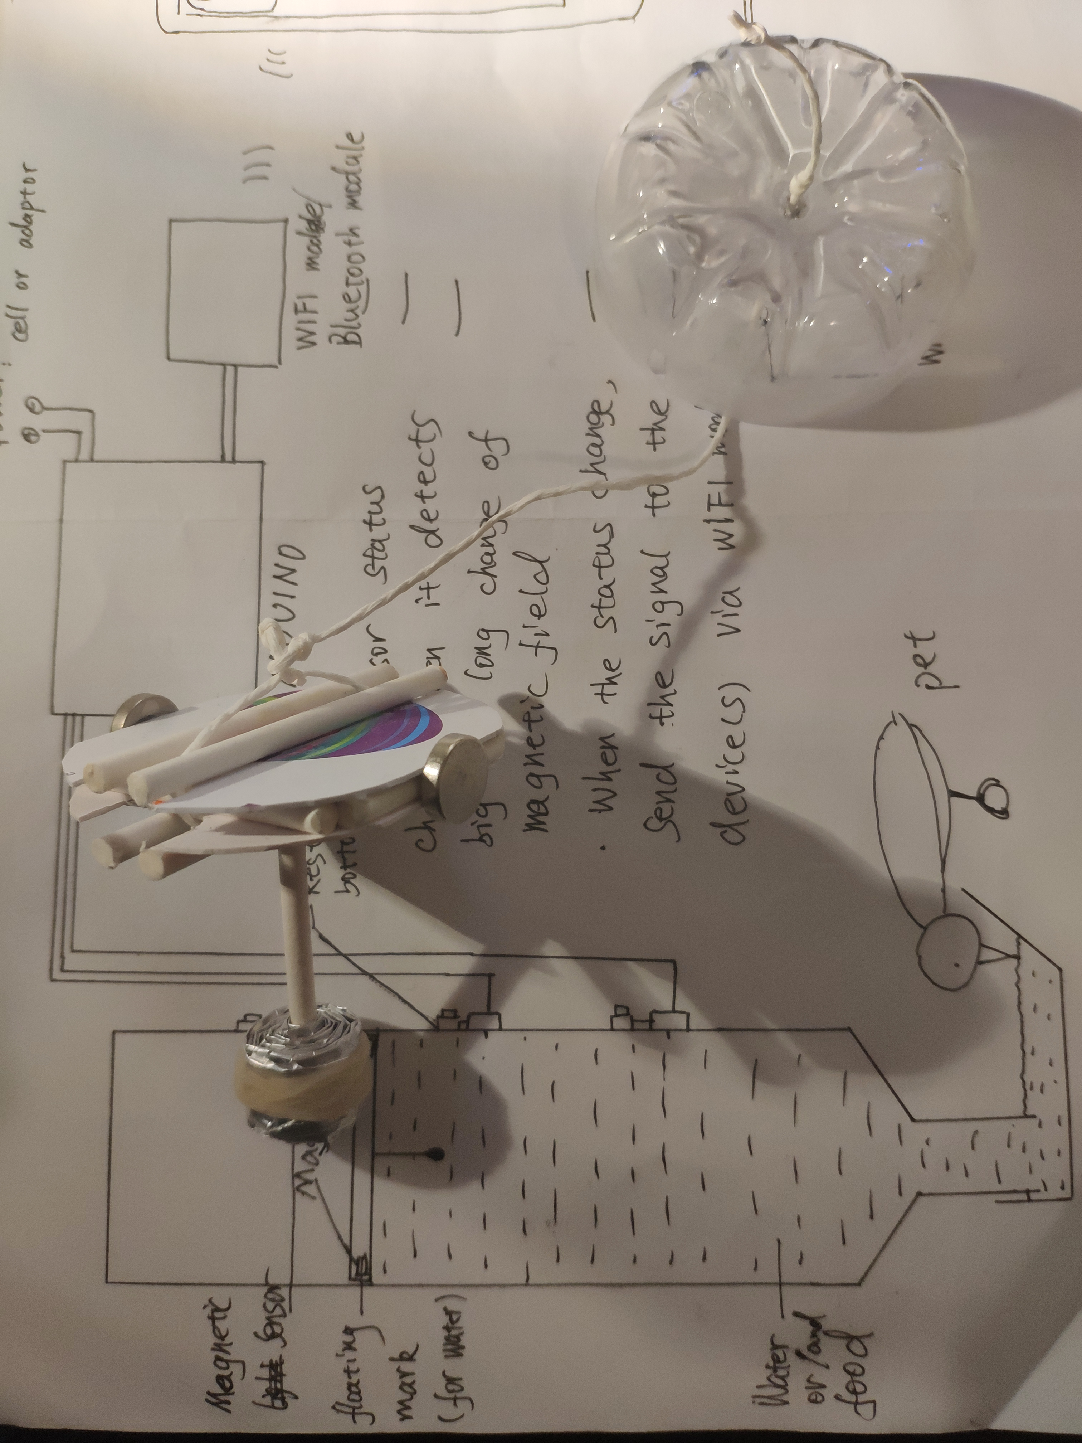
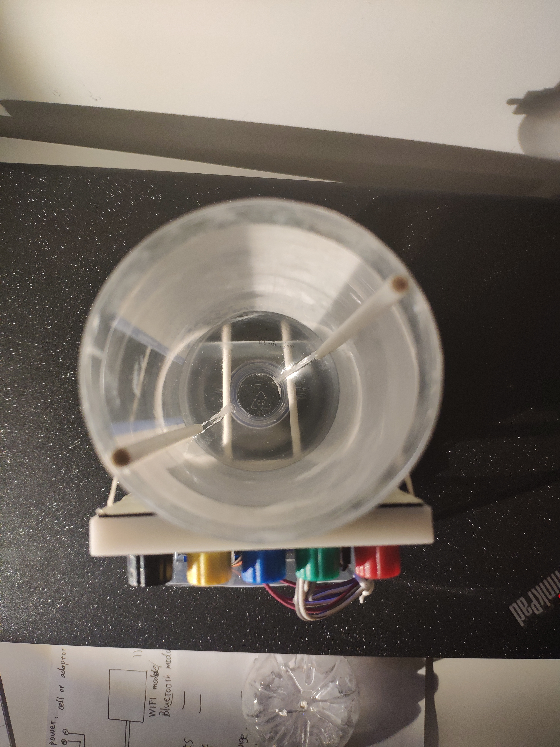
Prototype
Two magnets
Two rails
for the floating mark
Four guide sticks
Rope
Lid
Counterweight

Slide 4
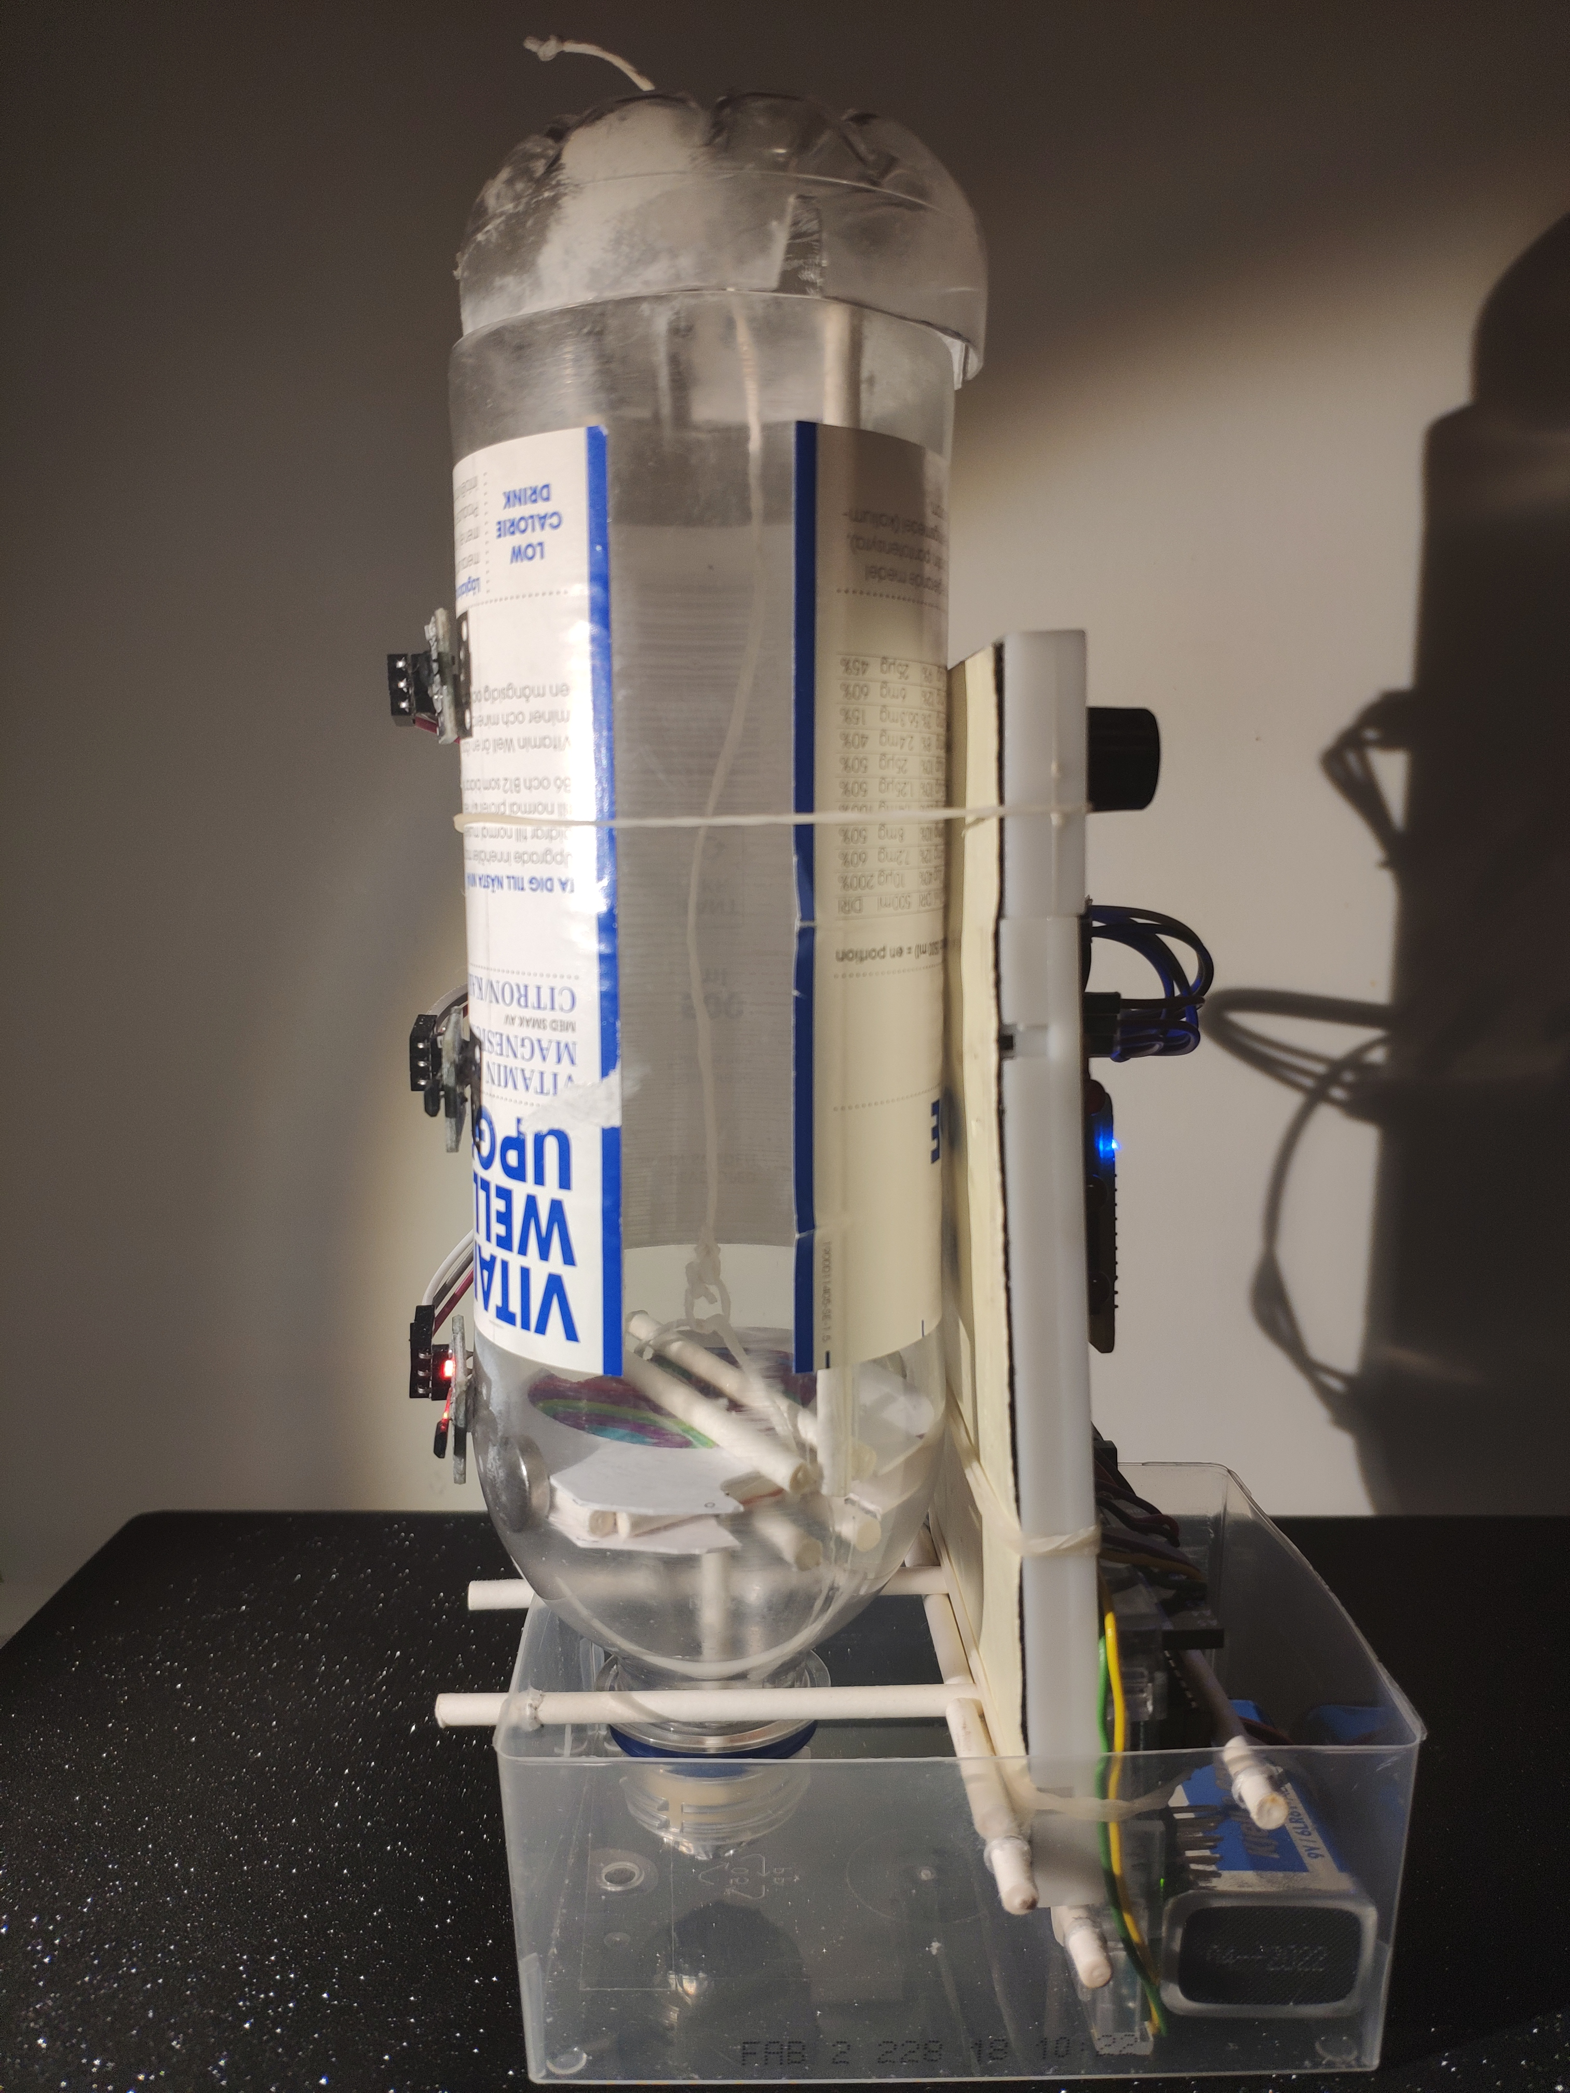
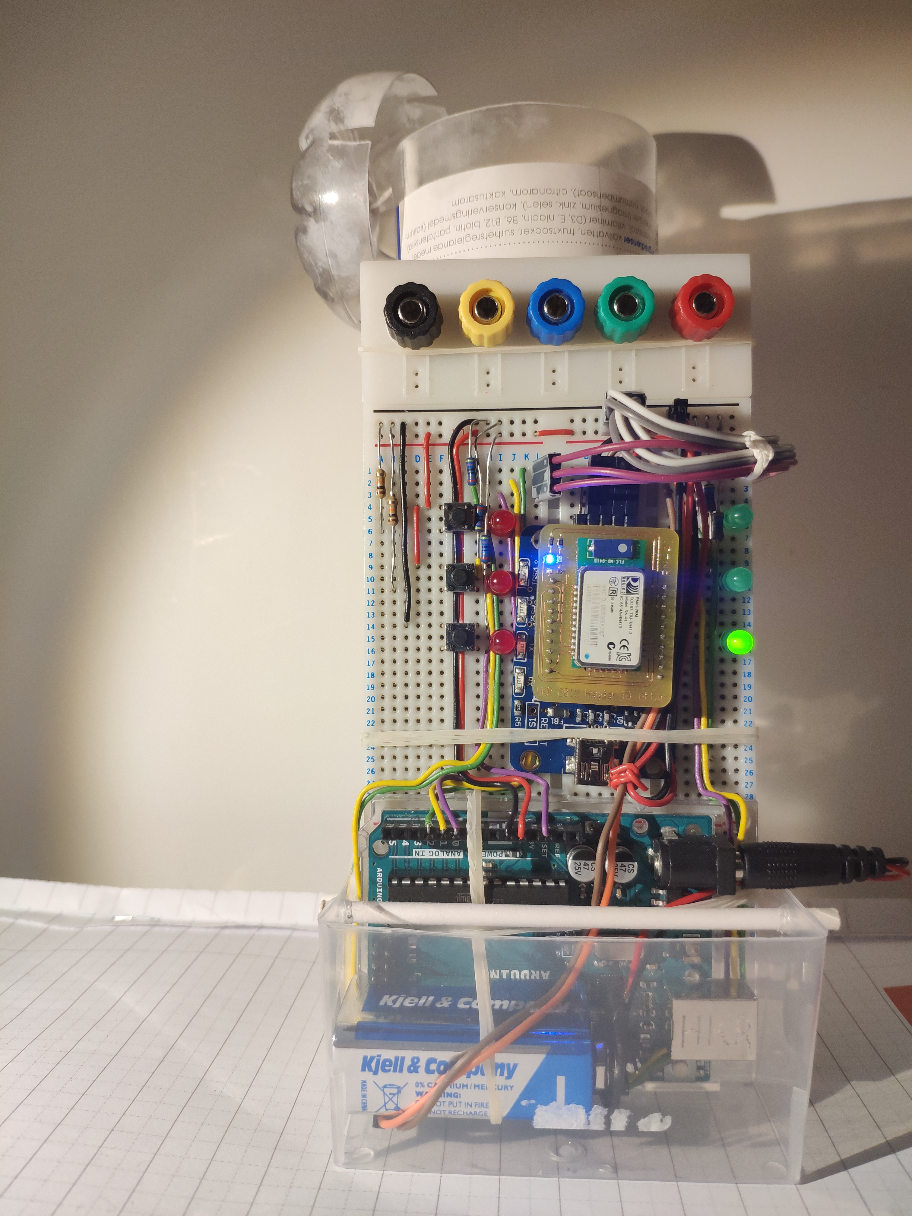
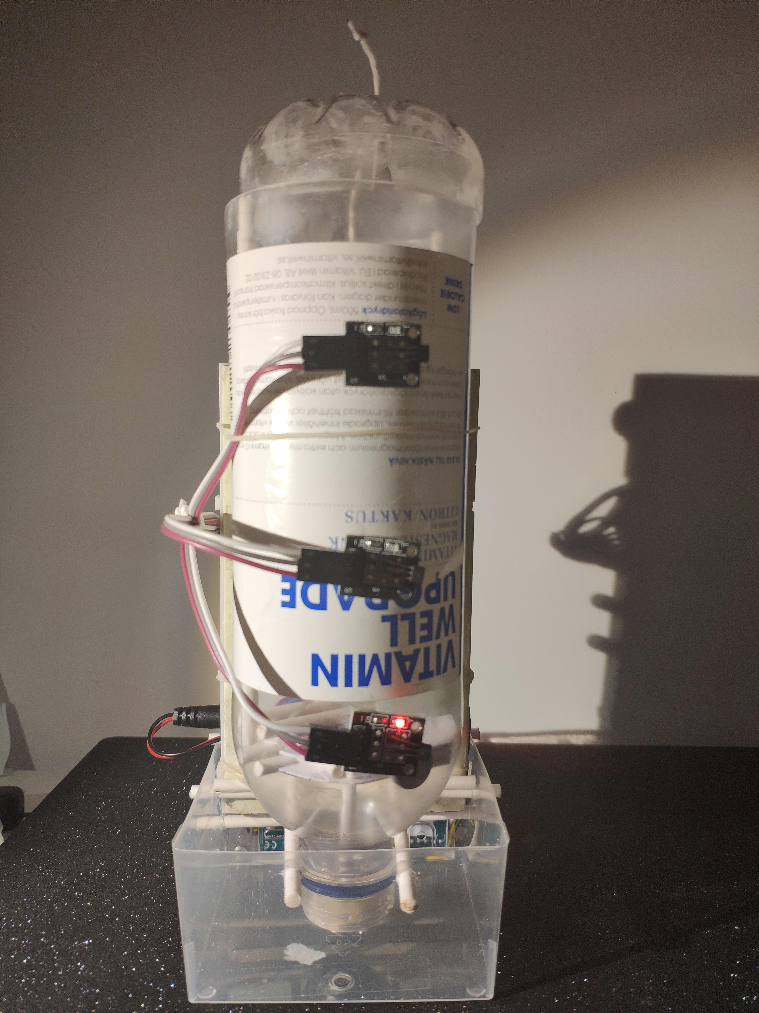
Requirement1: Interrupt
3 interruption
indicator lights
Bluetooth module
3 level indicator lights
2 interrupt buttons
Hall effect sensor and magnet
reset button (used as an interrupt button)
3 hall effect sensors
Battery

Slide 5
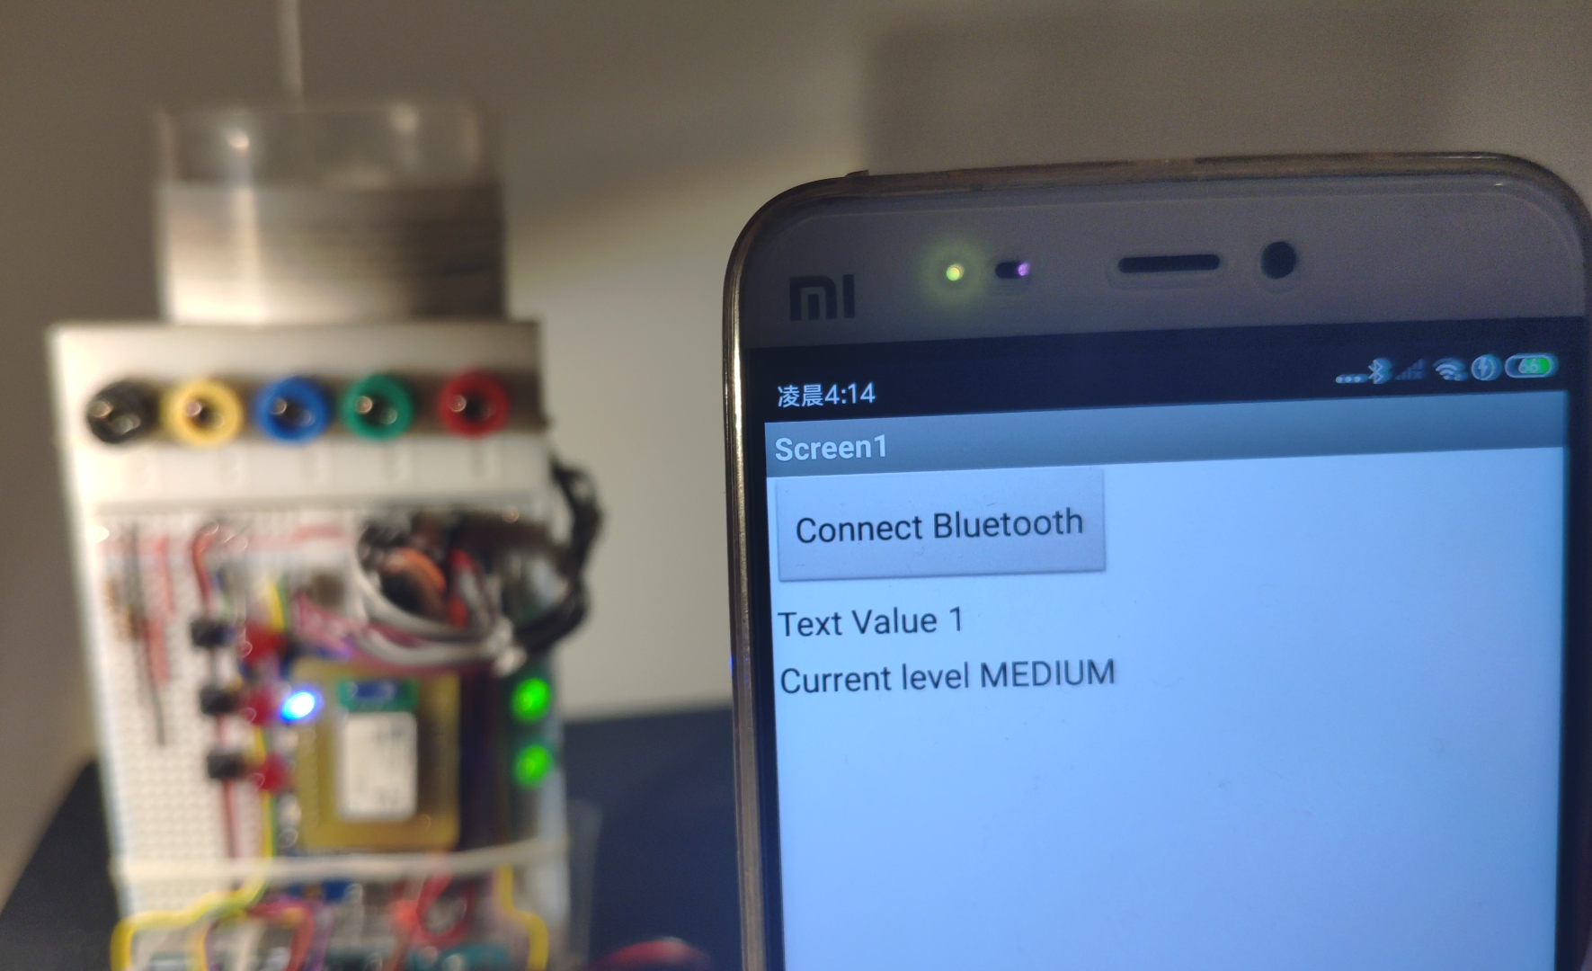
Arduino - Android device communication
Arduino
Receive data from sensor and interrupt button
Transfer data into valid information
Sent text value via Bluetooth module
Android device*
Receive text value
Interpret text value to readable message
*Test device: MI 5, Xiaomi Inc, China

Slide 6
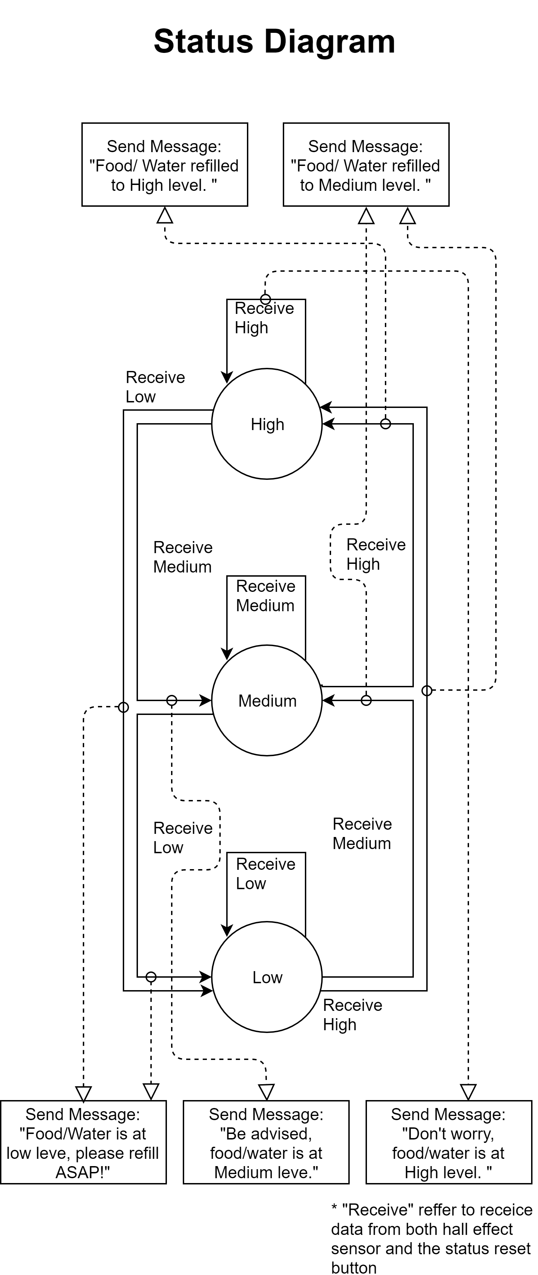
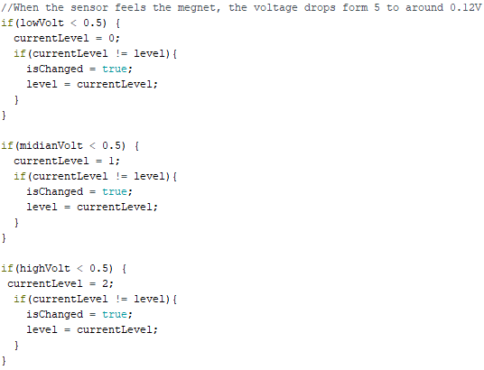
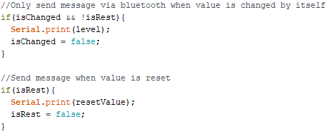
Inside the code
* I’ll later explain why it is 0.5
** When value changes, the Boolean variable “isChanged” set to true, so that the program will know if the level is changed
*** The code didn’t completely follow the status diagram since some interrupt can’t be done in Arduino Uno.

Slide 7
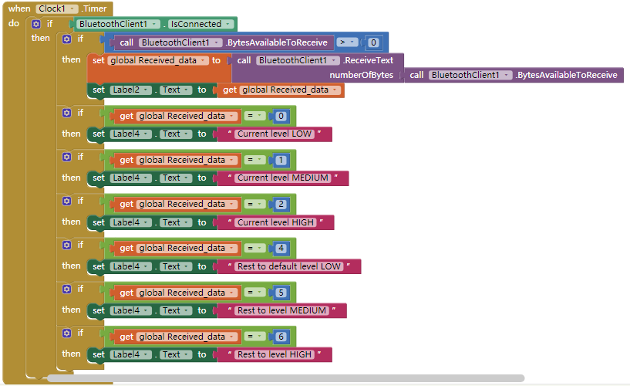
Android Application Design
Design tool: MIT appinventor
Message Interpreter
Notifier
Value | Text message
0 | “Current level LOW”
1 | “Current level MEDIUM”
2 | “Current level HIGH”
4 | “Rest to default level LOW”
5 | “Rest to level MEDIUM”
6 | “Rest to level HIGH”

Slide 8
Requirement i: Interrupt
Interruption is applied here for resetting the level value when the actual level isn’t what the Arduino think it is.
Reset button “Reset High”
Reset button “Reset Medium”
Reset button “Reset Low”
Since Arduino Uno only has two interrupt pins, I made use of the “RESET” pin, which is when the user want to reset the level to Low, the whole Arduino resets and the level value goes back to Low.

Slide 9
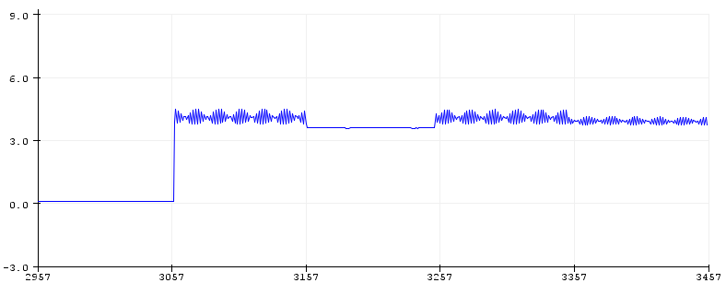
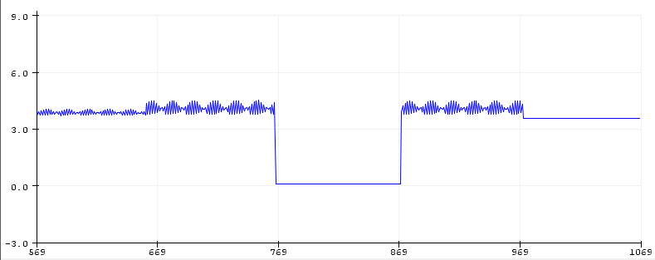
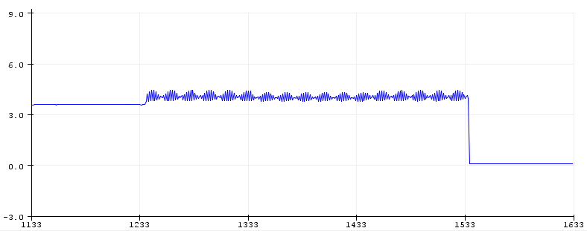
Requirement ii: Analog to digital conversion
Analog input: Hall effect sensor
Little research: Push the floating mark from top to bottom in the same speed and read the diagram shown in the Arduino IDE.
When sensor doesn’t feel the magnet, the voltage of the signal looks like sine wave.
Three sensors does interfere each other when any one of them feels the magnet.
Luckily, the interference is acceptable and will not alter the result.
Digital output: LEDs and Bluetooth signal
LEDs: Digital write
Bluetooth: Serial print
Conversion
Set when the voltage is bigger or equal to 0.5, treat it as 1 (or High).
When it is smaller than 0.5, treat it as 0 (or Low).
The top sensor
The middle sensor
The low sensor

Slide 10
Last but not least
Thank you for listening!

